Slide 1

Temperature And Humidity Measurement using DHT11
Sararah Mahjabin
ID: 18101067

Slide 2
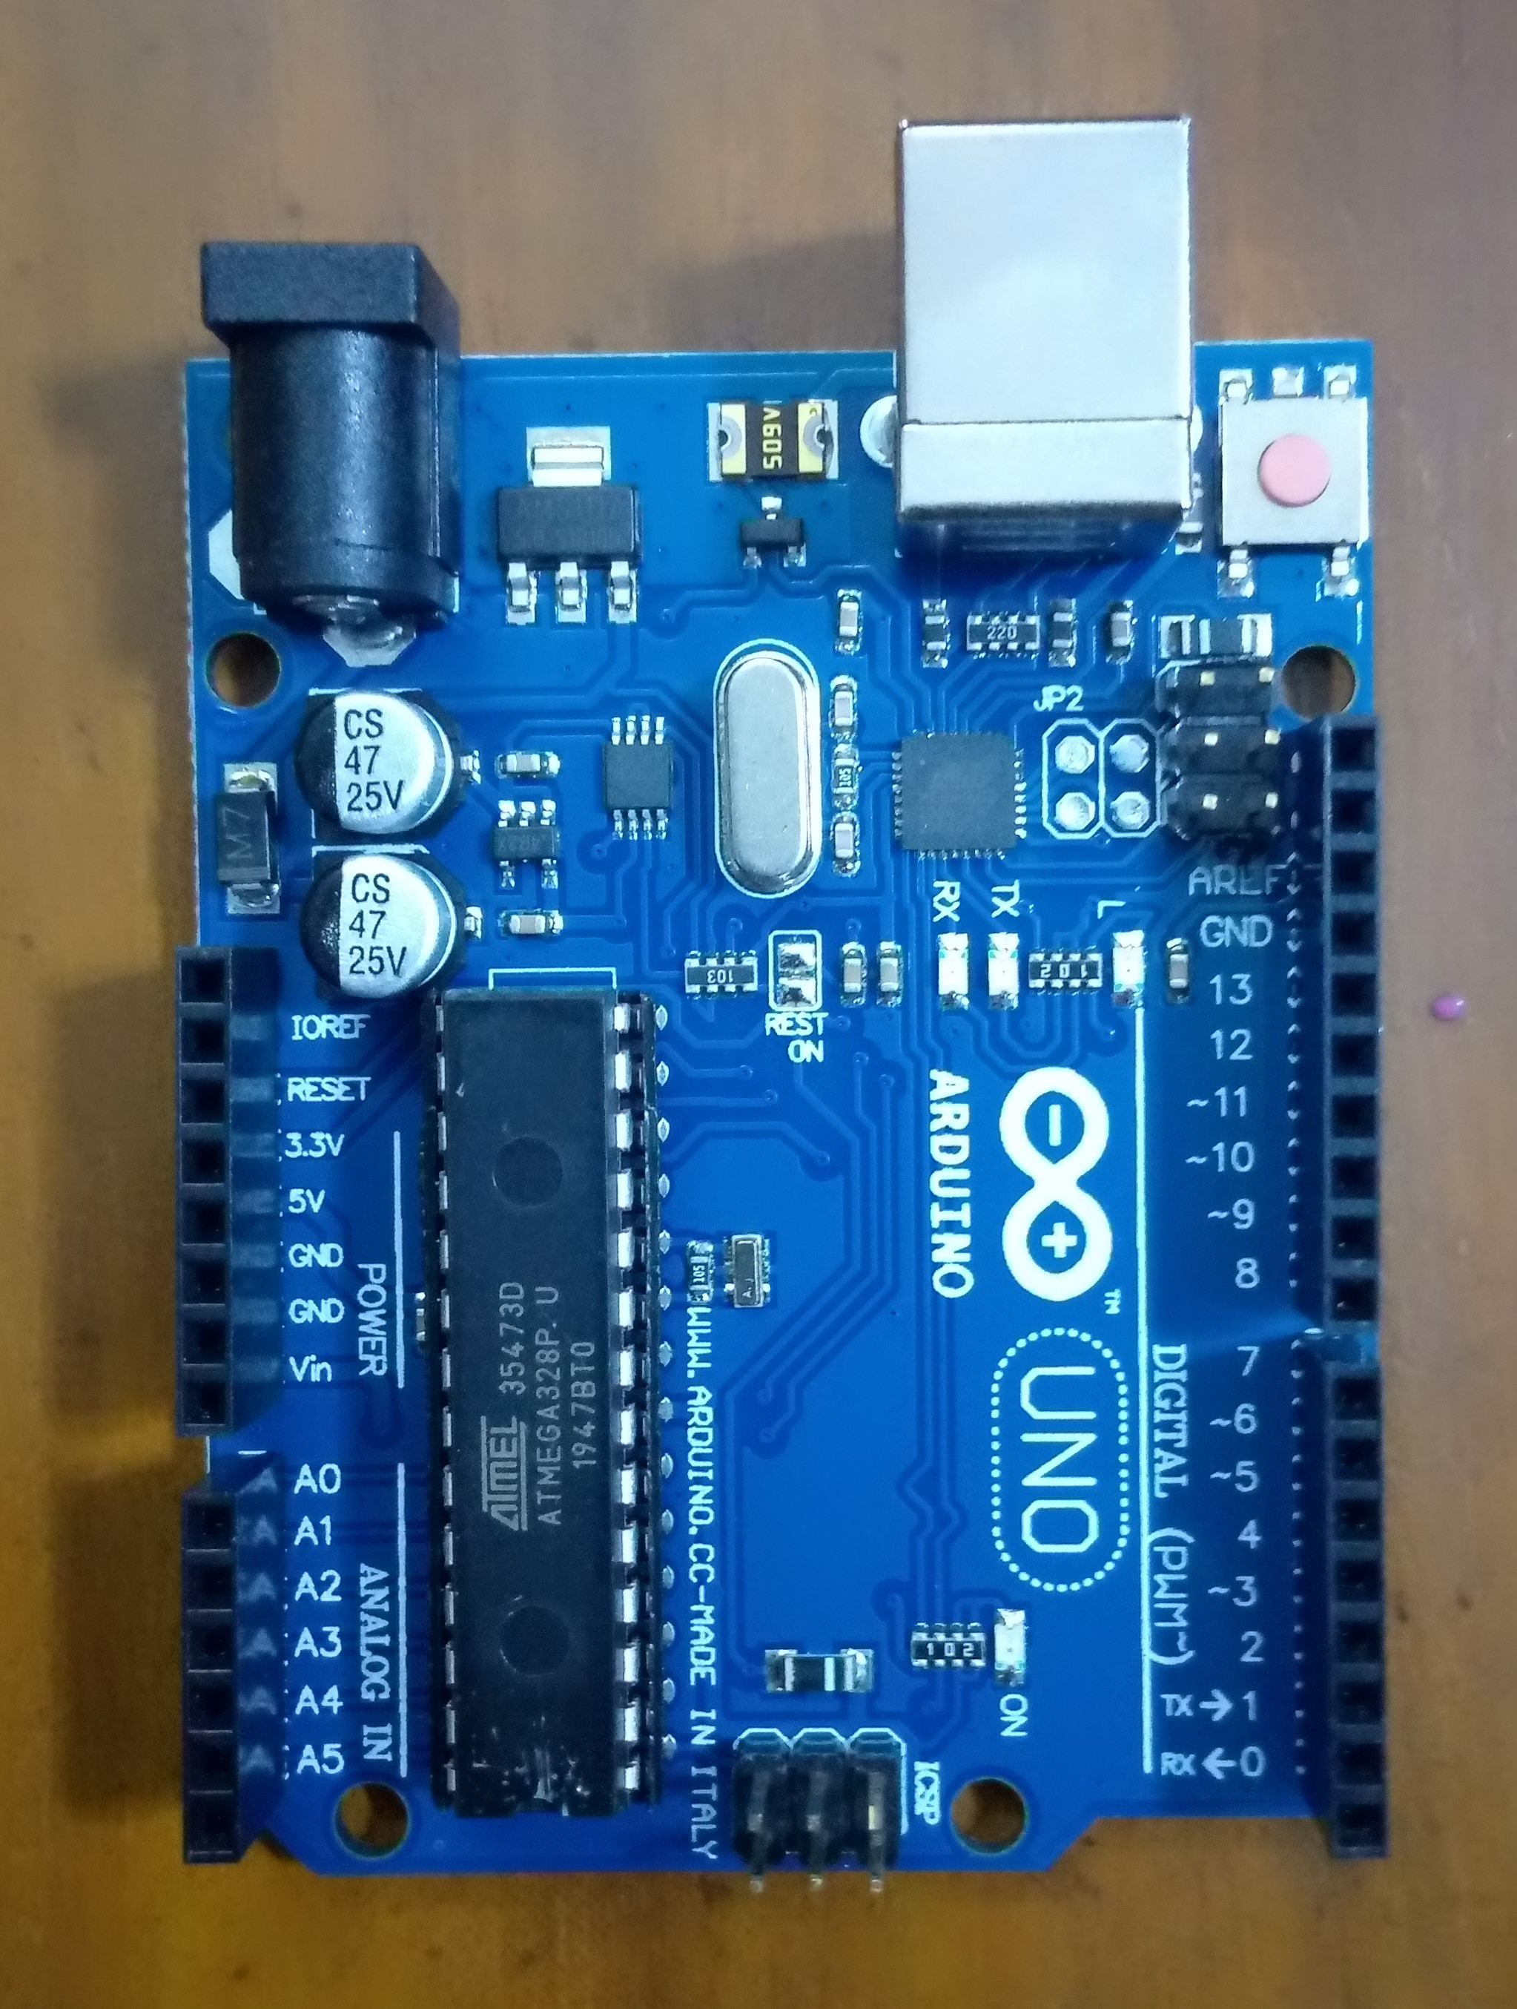
Project Equipments
Arduino Uno Board:
16Mhz ATmega328 processor.
Memory size 2KB SRAM, 32KB flash.
It accepts voltages between 6 to 20 volts.

Slide 3
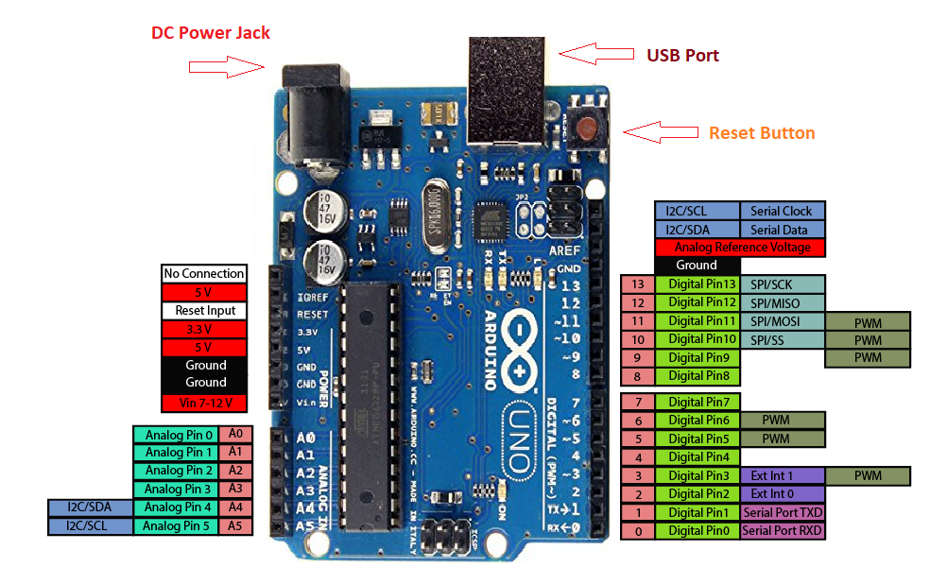
Project Equipments
Pin configuration of Arduino Uno Board:
Fig.01: Pin Configuration of Arduino Uno

Slide 4
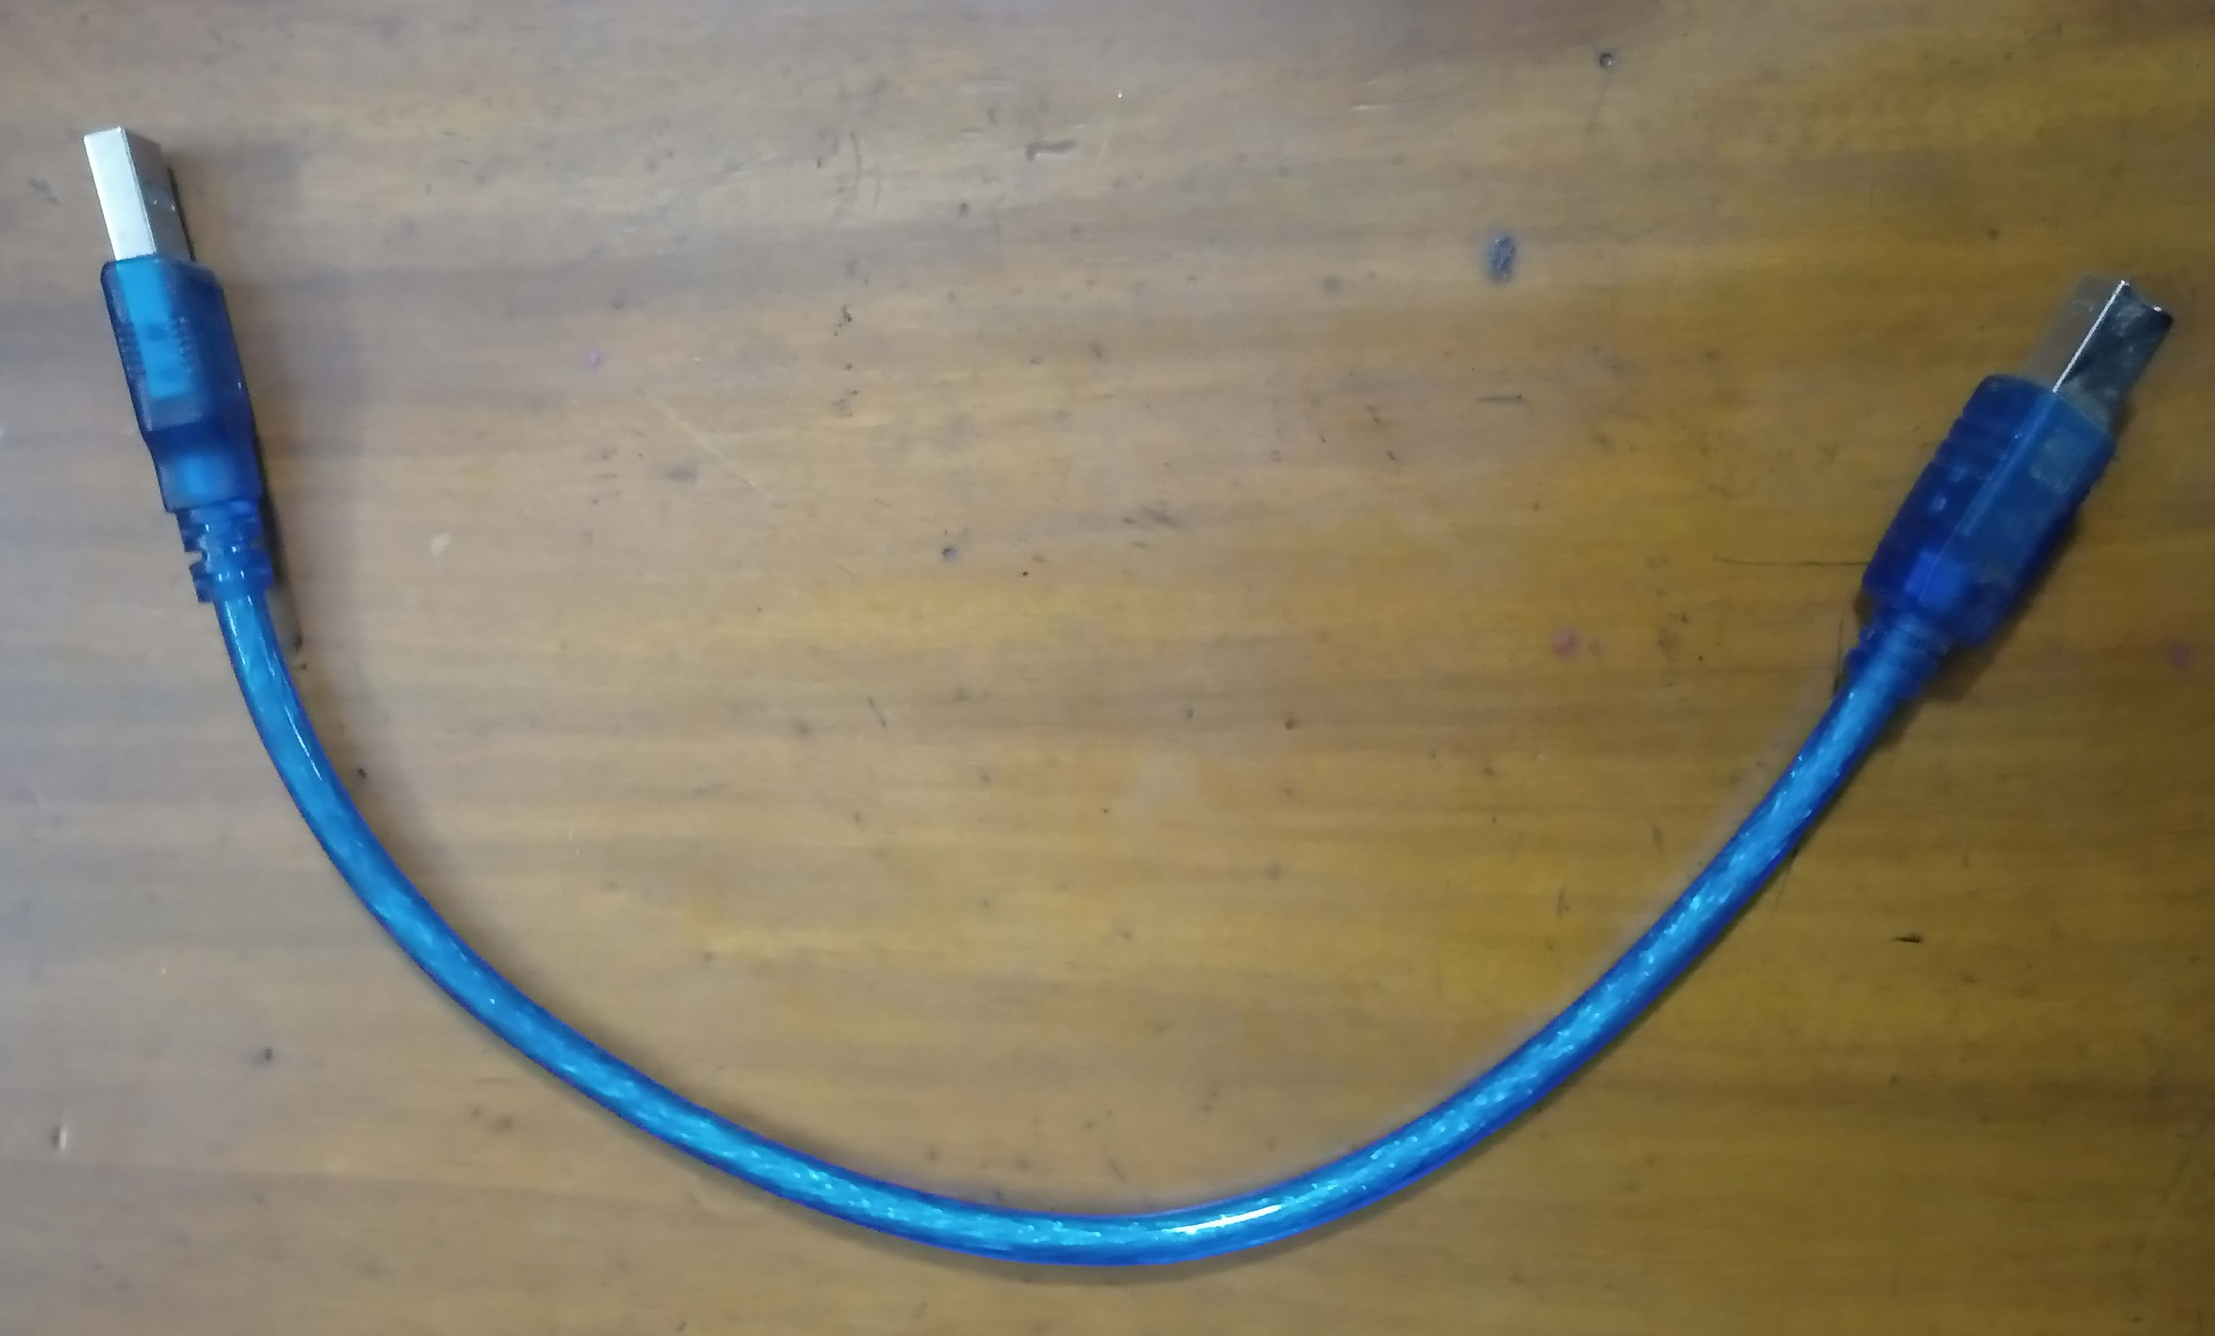
Project Equipments
Arduino Uno USB Cable:
Connect Arduino Uno board with the USB port of a PC or Laptop.

Slide 5
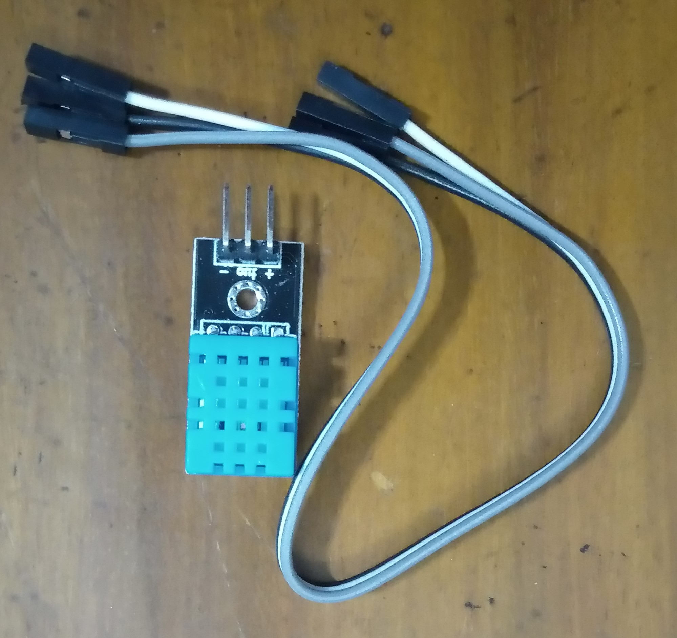
Project Equipments
DHT11 Sensor:
Operating voltage 3.5V to 5.5V.
Operating current 0.3mA(measuring) 60uA(standby).
Temperature range 0°C to 5°C .
Humidity range 20% to 90% .
Accuracy ±1°C and ±1% .

Slide 6
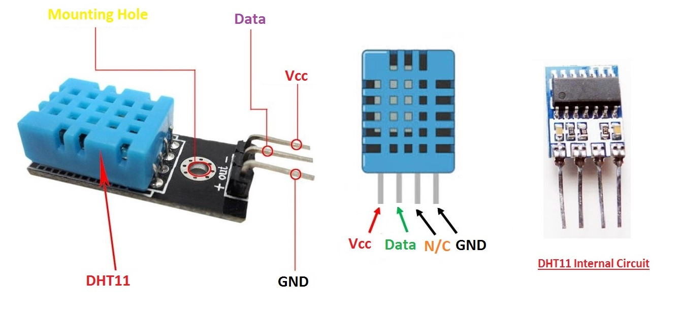
Project Equipments
Pin configuration of DHT11 Sensor:
Fig.02: Pin Configuration of DHT11

Slide 7
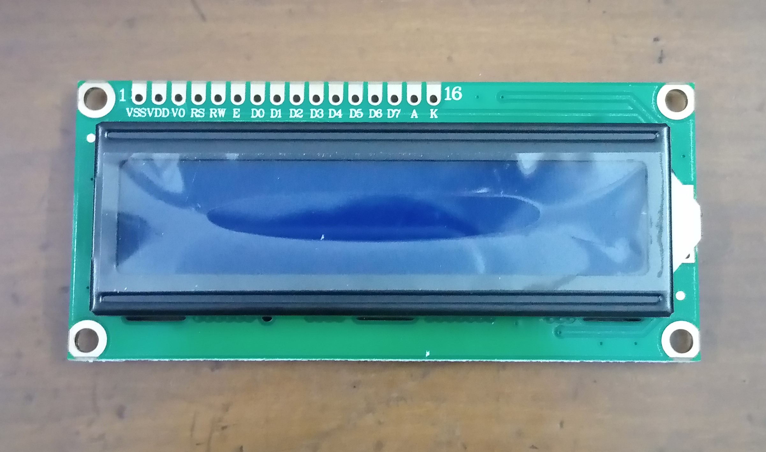
Project Equipments
LCD(16 x 2):
Translate and display 16 characters per line.
Displays in 2 such lines.
Each character is displayed in a 5 x 7 pixel matrix.

Slide 8
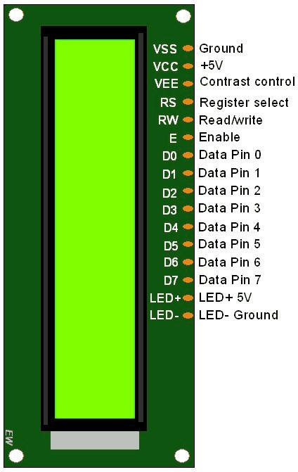
Project Equipments
Pin Configuration of LCD (16 x 2):
Fig.03: Pin Configuration of LCD

Slide 9
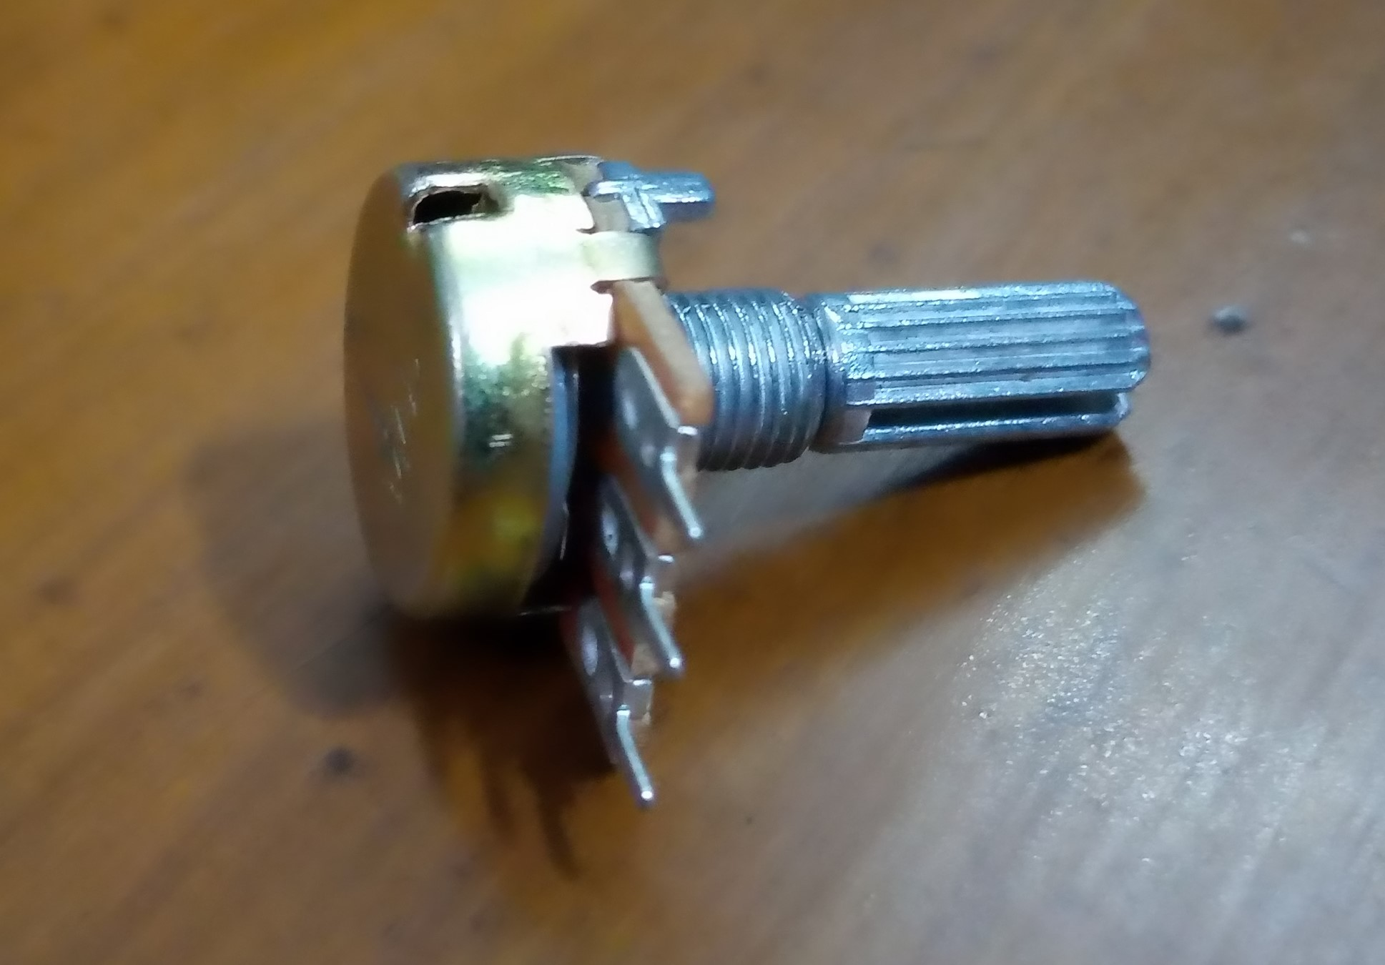
Project Equipments
Potentiometer (10k):
Manually adjustable variable resistor.
Resistance varies from 0Ω to 10kΩ .

Slide 10
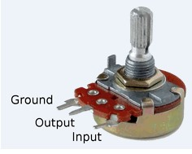
Project Equipments
Pin Configuration of Potentiometer:
Fig.04: Pin Configuration of Potentiometer(10k)

Slide 11
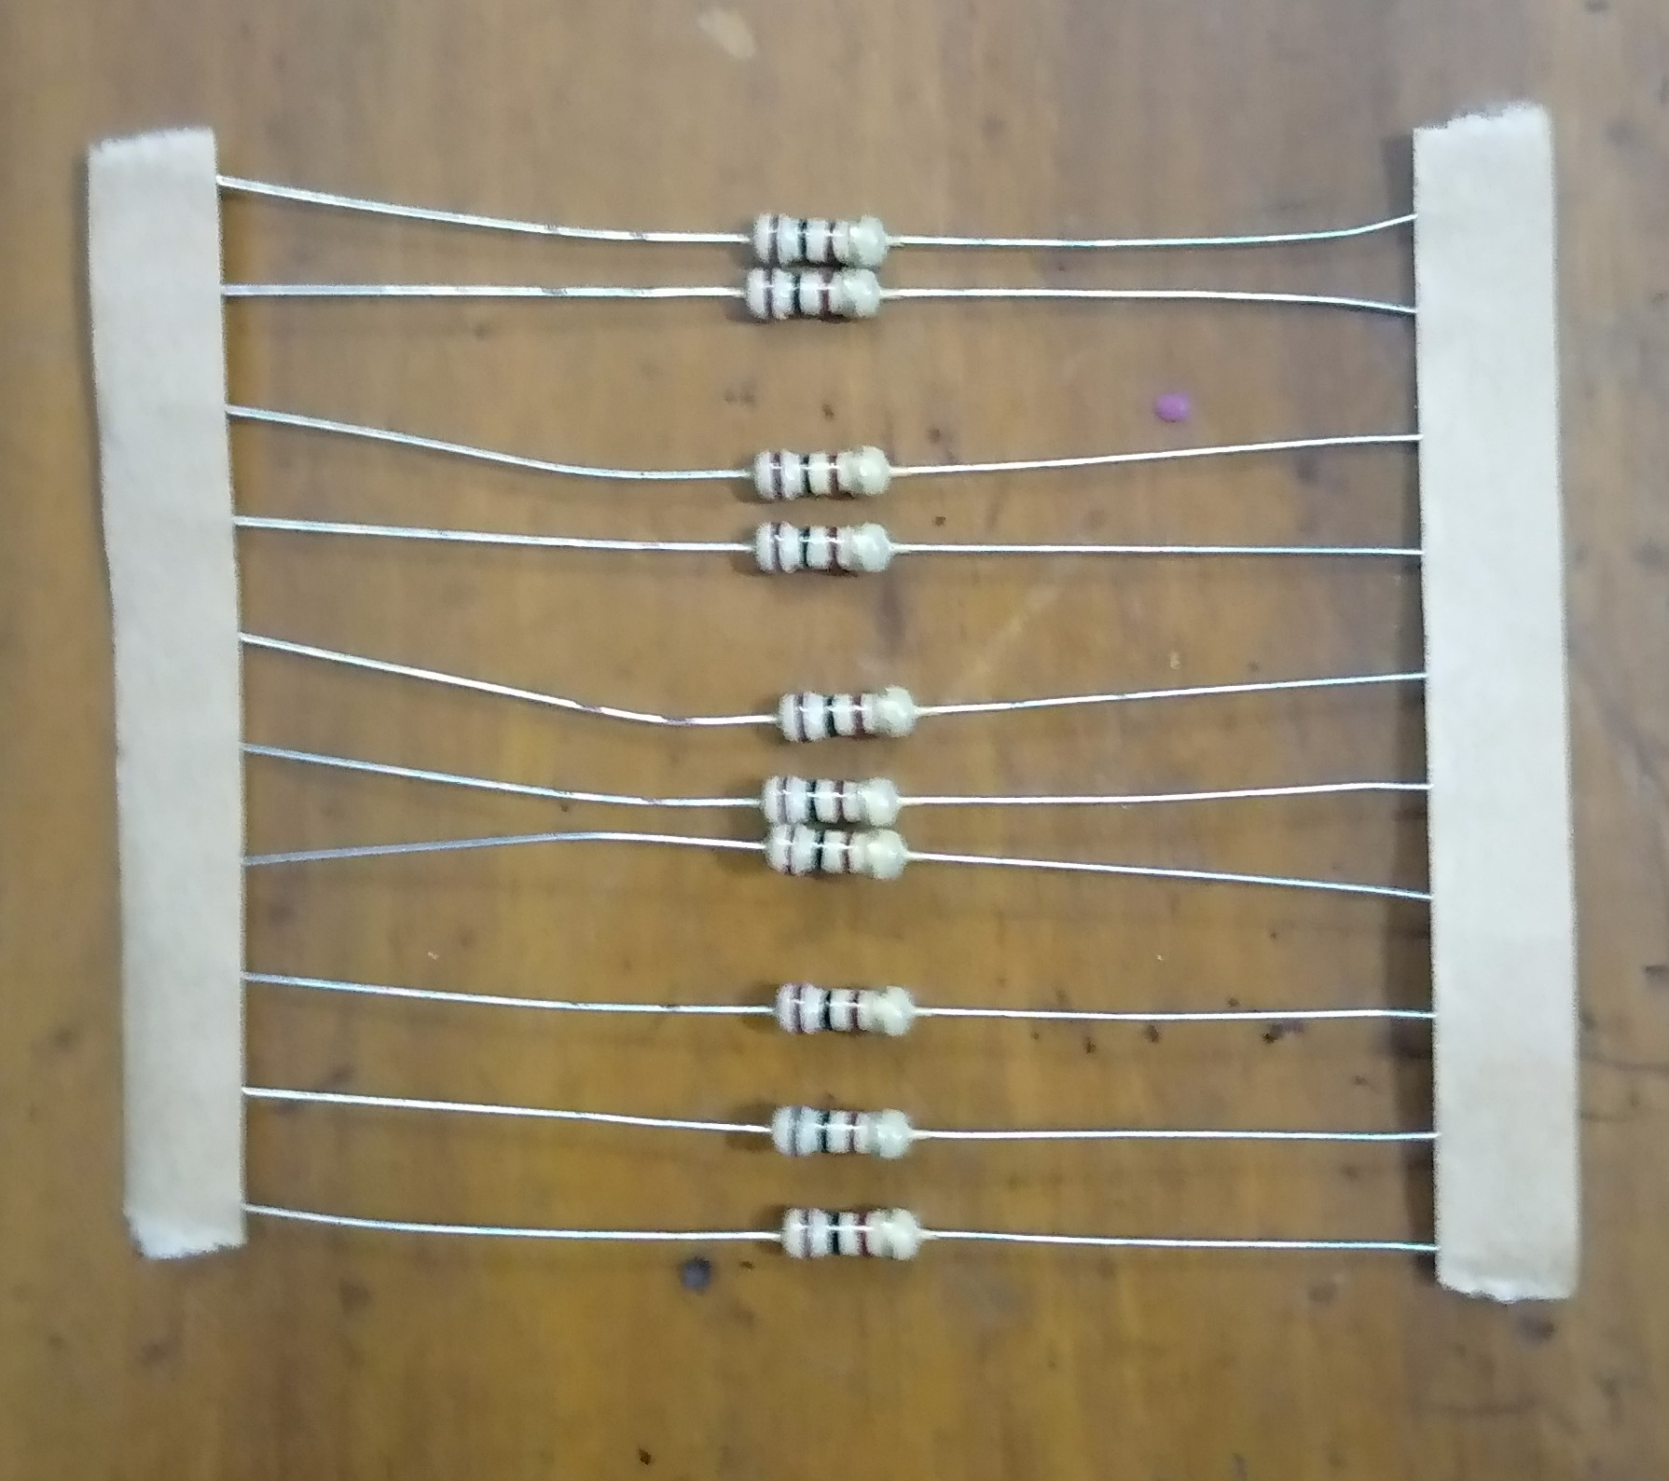
Project Equipments
Resistor (100Ω):
Reduce current flow.
Adjust signal levels.
Divide voltages.
Terminate transmission lines.

Slide 12
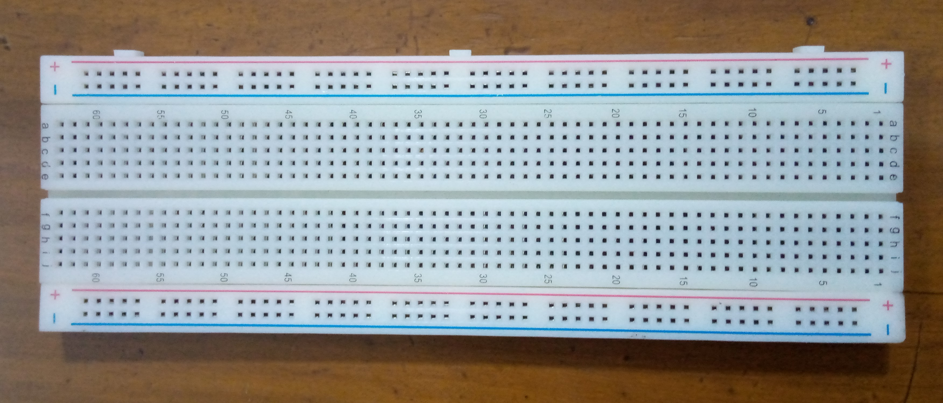
Project Equipments
Breadboard:
Allows to insert electrical components.

Slide 13
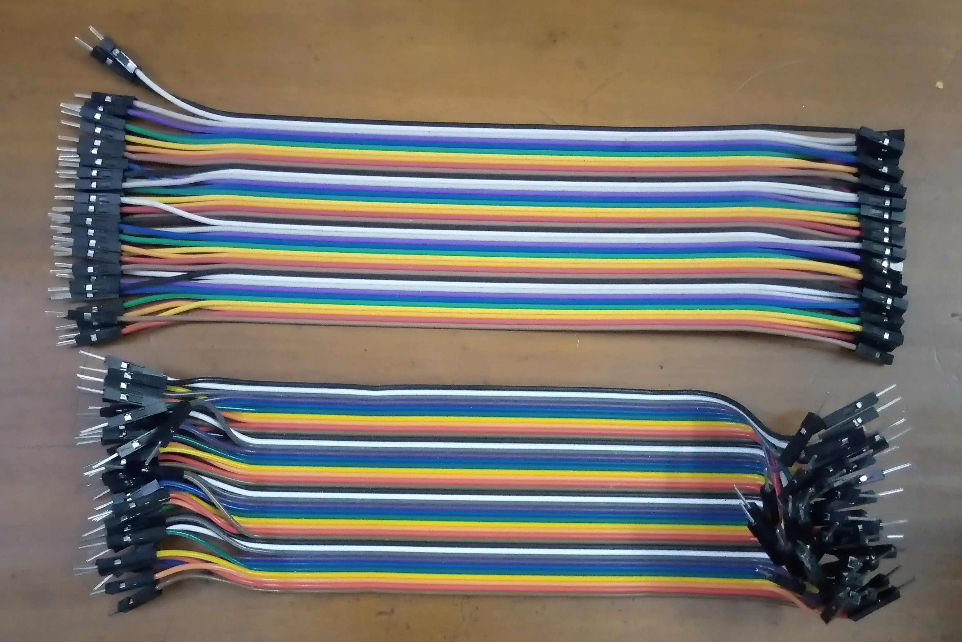
Project Equipments
Jumper Wires (Male to Male & Male to Female):
Interconnects the components of a breadboard

Slide 14
Any Question ?
Thank you

